Slide 1
Oblig 1
IN5450
Espen Lønes

Slide 2
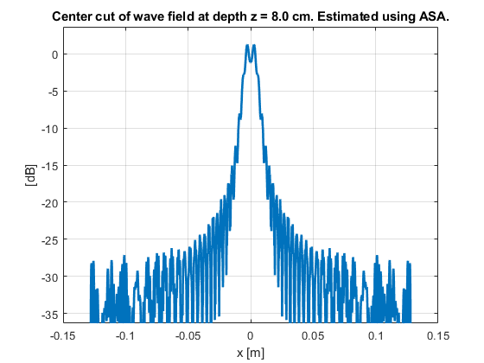
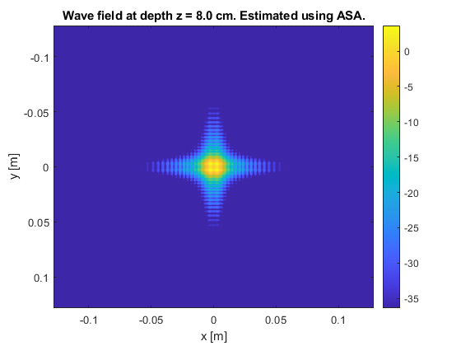
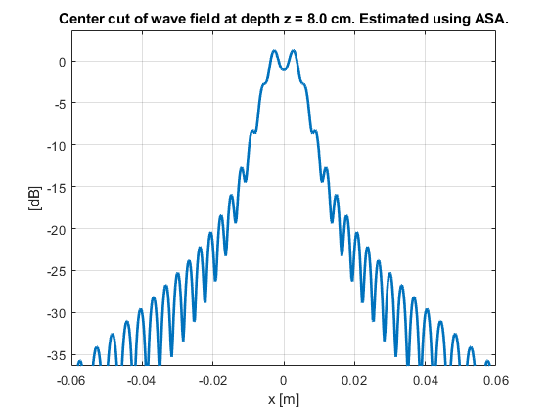

Unfocused ASA

Slide 3
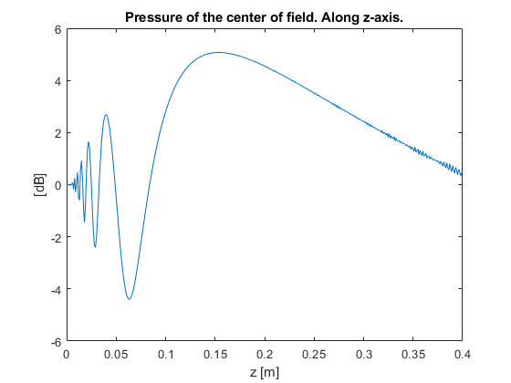
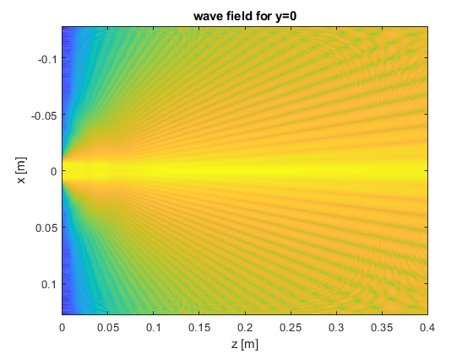

Slide 4
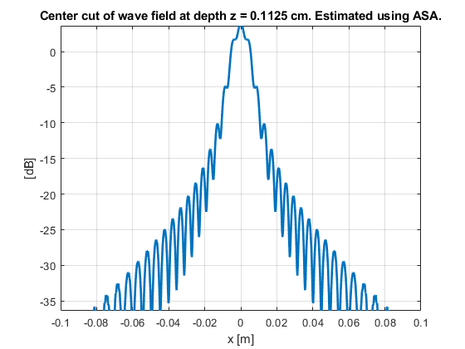
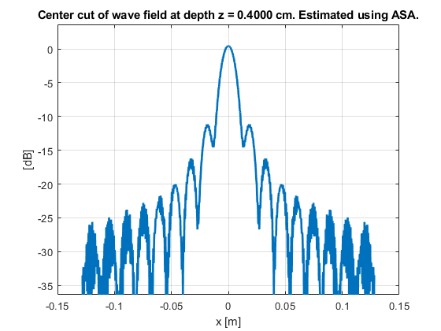
Near/far-field limit
NF limit =(15*lmd)^2 / lmd

Slide 5
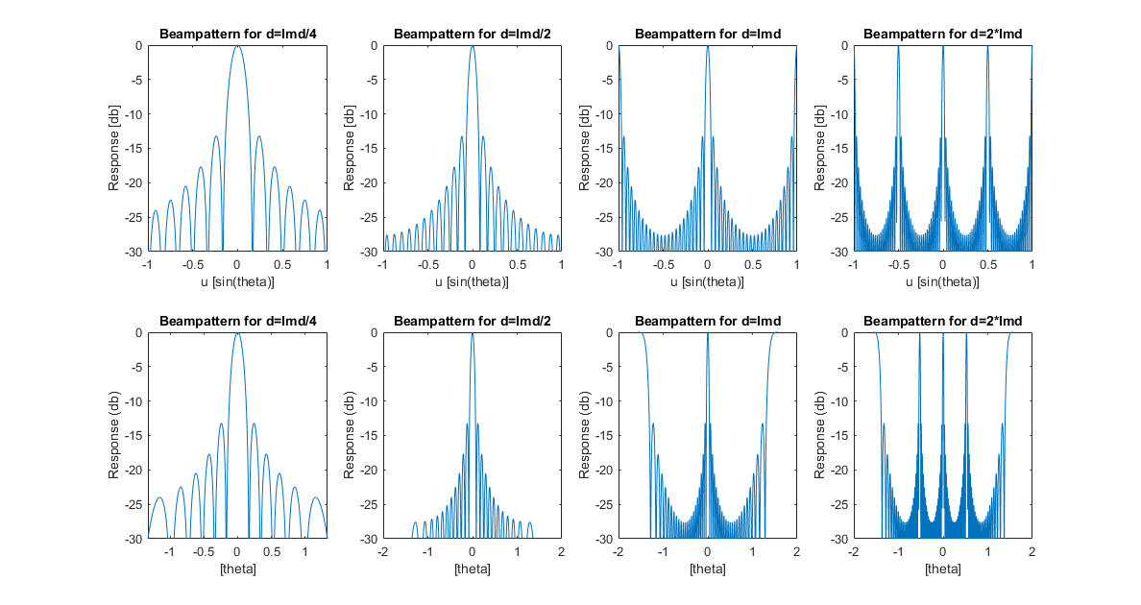
Grating lobes for M=24 arrays

Slide 6
Main lobe / Side lobe values
D = lmd/4
-3 dB: 0.1445
-6 dB: 0.2011
Max SL: -13.2123
ML width: 0.3330
D = lmd/2
-3 dB: 0.0691
-6 dB: 0.0942
Max SL: -13.2108
ML width: 0.1696
D = lmd
-3 dB: 0.0314
-6 dB: 0.0440
Max SL: 0
ML width: 0.0817
D = 2*lmd
-3 dB: 0.0126
-6 dB: 0.0188
Max SL: 0
ML width: 0.0440

Slide 7
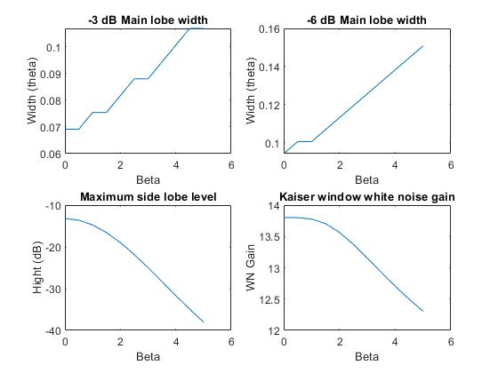
Element weighting with Kaiser
M = 24
D = lmd/2
WNG = ||w|||^-2

Slide 8
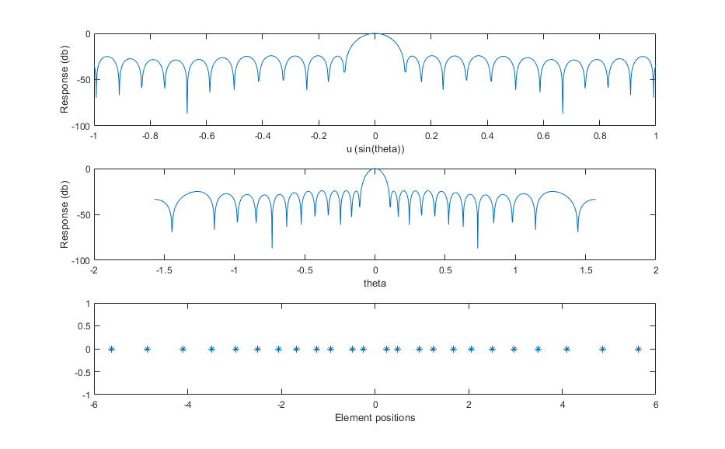
Non uniform spacing
D = lmd/2
-3 dB: 0.0817
-6 dB: 0.1131
Max SL: -24.1110
ML width: 0.2199

Slide 9
Comparison
Uniformly spaced
-3 dB: 0.0691
-6 dB: 0.0942
Max SL: -13.2108
ML width: 0.1696
Kaiser window
Non uniform spacing
-3 dB: 0.0817
-6 dB: 0.1131
Max SL: -24.1110
ML width: 0.2199

Slide 10
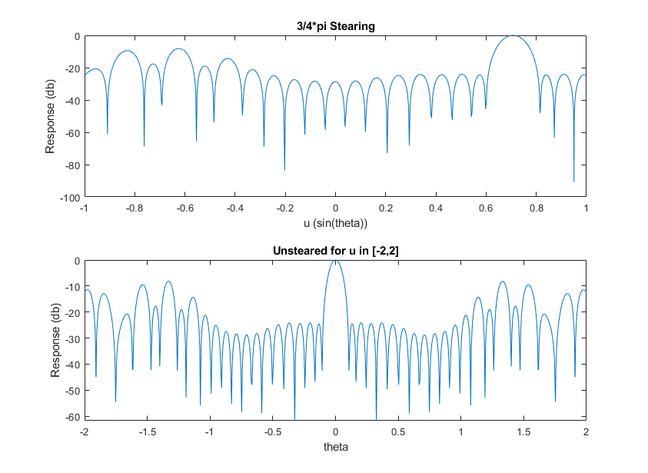
Array steering

Slide 11
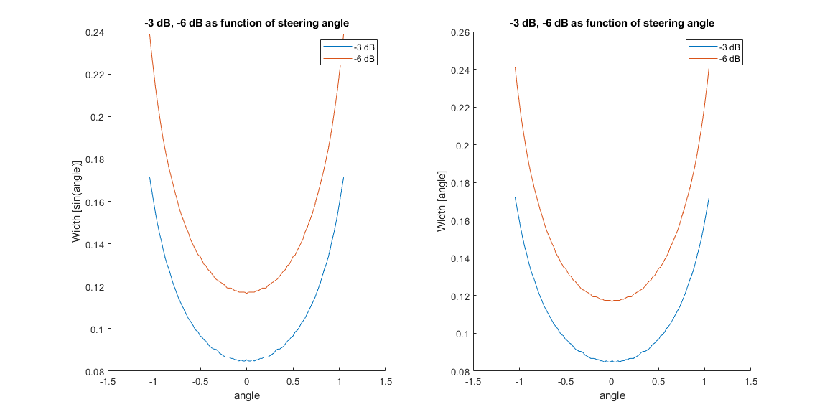
ML widths for different searing angles

Slide 12
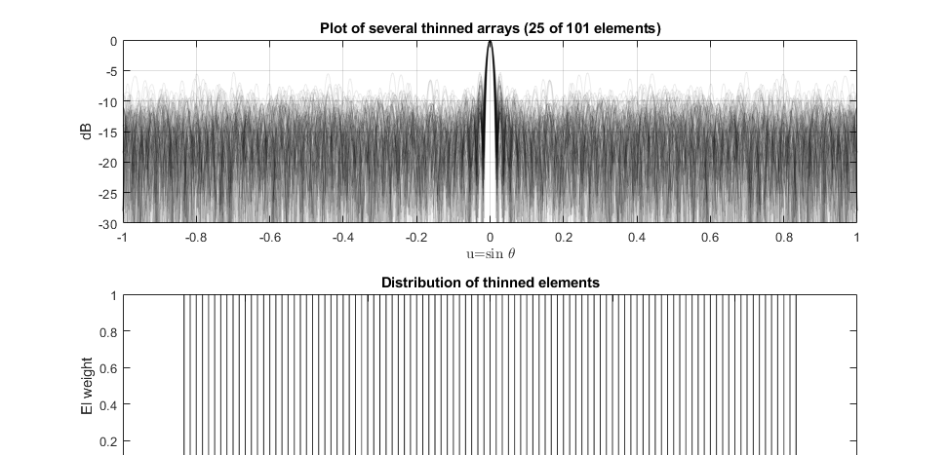
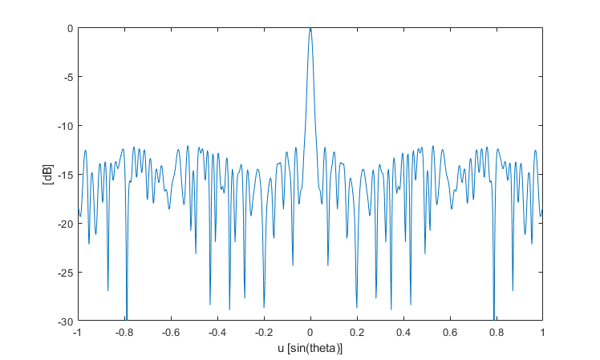
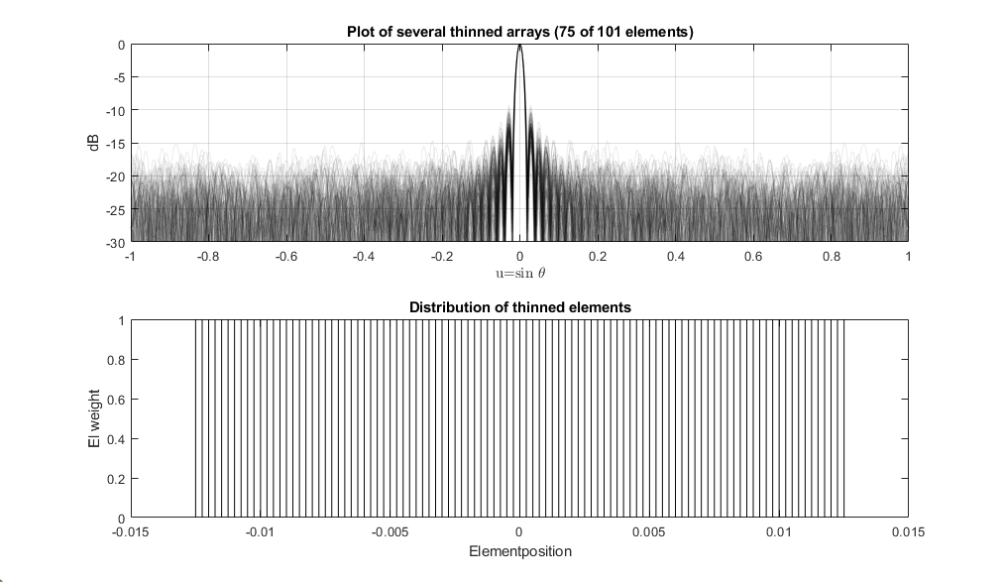
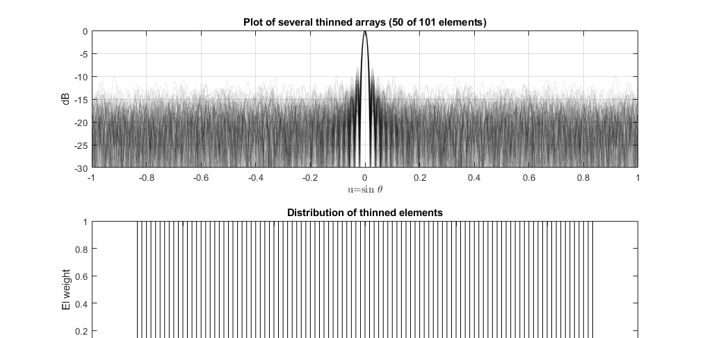

Slide 13
ML / SL levels for thinned arrays
N = 25
ML width mean = 0.0395
ML width sd = 0.0070
SL mean = -7.6231
SL max = -4.9549
N = 25 ‘optimal’
ML width: 0.1005
-3 dB: 0.0188
-6_dB: 0.0251
Max SL: -12.0864
N = 50
ML width mean = 0.0399
ML width sd = 0.0047
SL mean = -11.5458
SL max = -7.8645
N = 75
ML width mean = 0.0391
ML width sd = 0.0027
SL mean = -13.0197
SL max = -9.3122

Slide 14
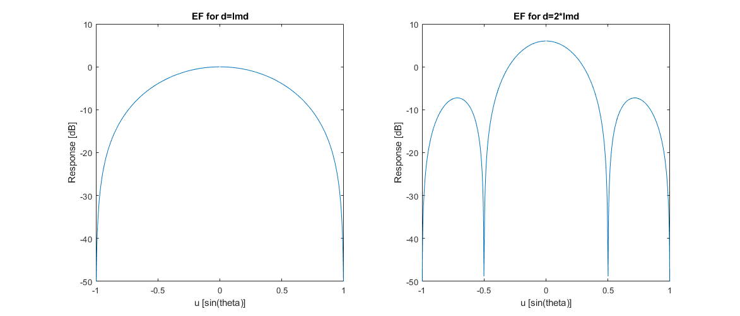
Directivity
Using
W_element = sin(kx.*d./2))./(kx./2);
Elements of size d

Slide 15
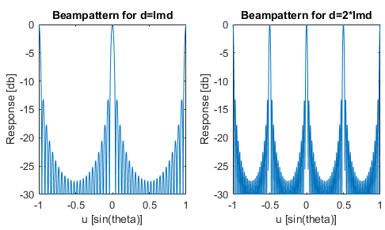
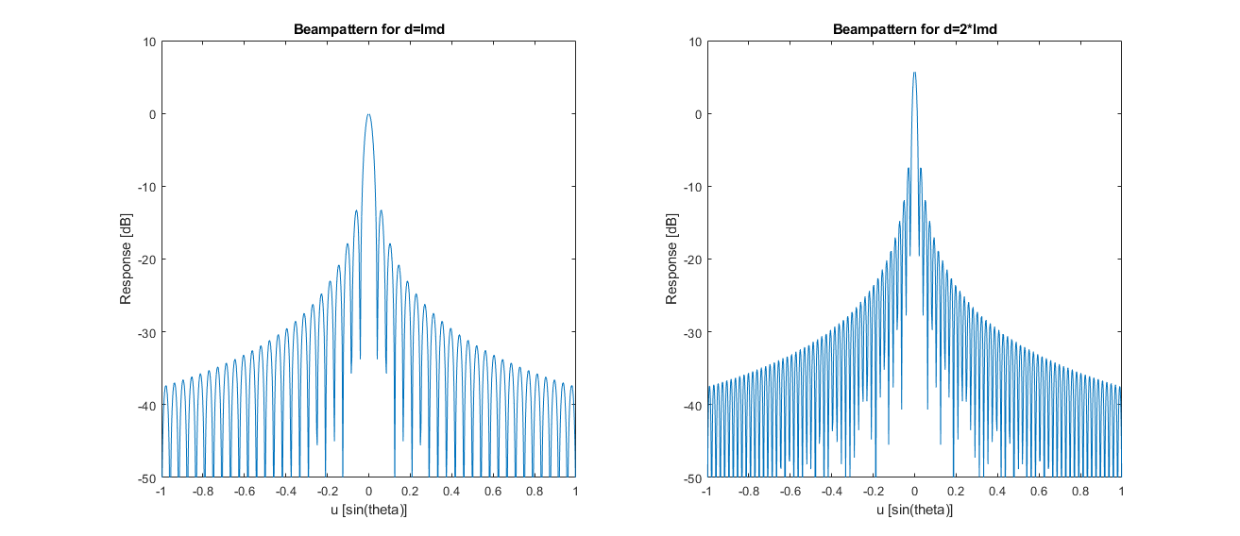
Compared (M = 24)

Slide 16
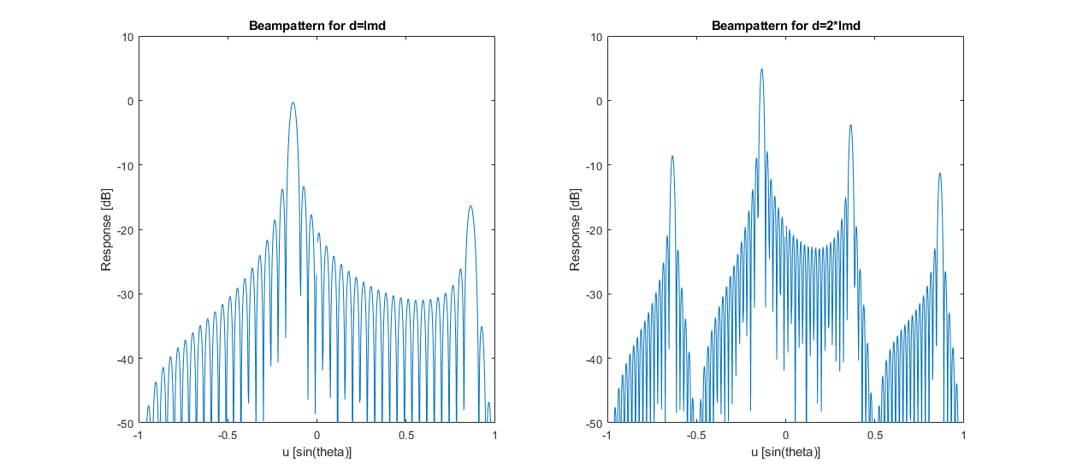
With element factor and searing

